Slide 1

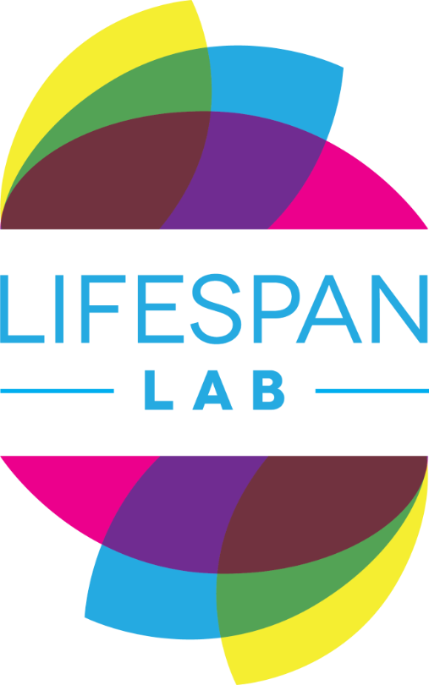
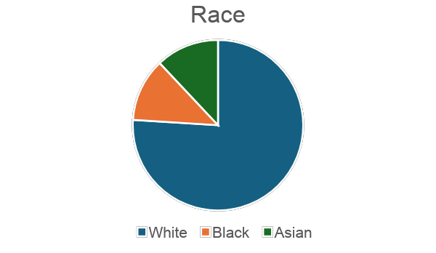
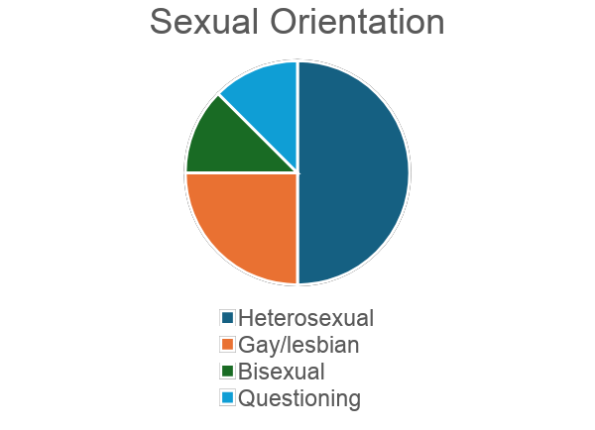
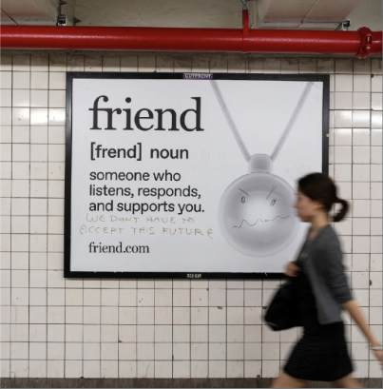
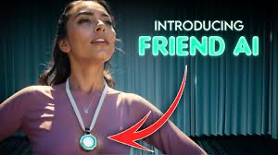
“Robots are Going to Take Over the World”: Perceptions of Ai Social Companions
Taryn Peteet, Zoe Berg, Autumn J. Ruggles¹, Ada J. Nicodemus¹, Clare M. Mehta, PhD^{1,2}
¹Emmanuel College, ²Boston Children’s Hospital
– ABSTRACT –
– METHODS –
Skill Reduction
“it takes away from emotional intelligence, being able to recognize body language…I think these chat bots, we obviously can't see them, we can only hear them, so that can definitely cause some damage”
Risks to Morality
“you lose the attachments of social norms. You don't understand, then maybe you'll learn lying is it is not wrong anymore”
Dependency
“Dependency [is]an issue. The less social you become, the more you depend on it. You just keep going down that hole where like, now you're dependent on this, and now you're not likely to talk to anybody, where if you become more social, you're less likely to use the chat box.”
3. Good Use Cases for AI
Support for Mental Health
“I've seen, people who are generally anxious [ai can] kind of help them to rationalize their thoughts, like this is how I'm feeling. Please tell me that this is either justifiable or not justifiable based on what's going on around me”
Alleviation of Loneliness
“I feel like it can be a friend to people that, like, really need it. It can help with loneliness and it can help with people who need that friend”
As ASCs become increasingly available, it is important to understand people’s perceptions of the risks and benefits and the potential social and psychological consequences of using ASCs.
The present study reports on the results of two focus groups conducted with 16 undergraduate students, aged 19-22 (24% non-White; 81% female), recruited via flyers and social media posts. Participants watched a video advertisement for Friend ai and were then asked to share their thoughts about friend ai and the use of ASCs more generally.
Using thematic analysis, three superordinate themes emerged from the data. The first theme centered on AI Proliferation. The second theme emphasized the Dangers of AI Social Companions. The final theme identified Good Use Cases for AI.
Our research suggests undergraduates are skeptical of ASCs and raises questions about how our changing relationship with technology will impact social norms for human relationships.
Participants
16 undergraduate students, ages 19-22 (M age = 20.6, 70% female)
Procedure
Participants watched a video advertisement for the FriendAI social companion and were then asked to share their thoughts about the device and the use of ASCs in two focus groups.
– RESULTS –
Thematic analysis was used to identify three superordinate themes from the data along with several subthemes.
AI Proliferation
Fear of Technological Advances
“I think there is a reason why the next step of AI is [in] a social capacity and is like a friend. It's a way of making this rapidly developing technology seem harmless or more friendly, when in reality, it's the opposite of that”
Humanization
“The woman gendered it as ‘she’ and I think, personally, for right now for AI chats and friends, conscious users can use ‘it’ effectively. Having that barrier [by] calling it an ‘it’, or like knowing its true purpose. But by humanizing it, I think that can be dangerous,"
Need for Guardrails
“But who would do those regulations? Would it be federal government? State government? What legislative [body] would be the people deciding what that chat bot gets to do and gets to say, who it gets to talk to, and things like that…we need to put guidelines on this”
Dangers of AI Social Companions
Harm to Self and Others
“I've seen a lot of incidents on the news, where people that have used these chat bot websites, they've harmed themselves. They've used it so much to the point where the bot coerces them to do these harmful acts.”
– INTRODUCTION –
Increasingly, artificial intelligence (AI) is becoming a part of our lives (Pugh, 2024). It is estimated that there are more than a billion ai users globally, with chat gpt reporting 400 million users per month (Datareportal, 2025).
AI use has expanded beyond productivity, with the development of AI social companions (ASCs) designed to be used for companionship and social support ((Jones & Schonewille, 2025).
The media has reported on people’s increased reliance on AISC for social support, and has reported on individuals who have replaced human relationships with AI relationships (Liu et al., 2026)
Emerging adults tend to be early adopters of new technologies (.and are in a developmental period where social relationships shape identity and influence wellbeing (xx)
As such, in the present study we investigated how emerging adults think about ai social companions.
– DISCUSSION –
Our research suggests that emerging adults are currently skeptical of AI while also identifying some benefits.
Oftentimes it is tempting to dismiss or villainize AI, however, AI may be able to improve the wellbeing of emerging adults.
Due to the limited sample size and sole use of undergraduate students, it may be difficult to generalize these findings to emerging adults as a whole.
Future research should examine how emerging adults’ relationships with technology impact their human relationships.
For a copy of this poster please scan:
For more information, please contact the authors at lifespanlab@emmanuel.edu.

